Slide 1
Highly accurate protein structure prediction with AlphaFold (AlphaFold 2)
林思涵
2022/03/08

Slide 2
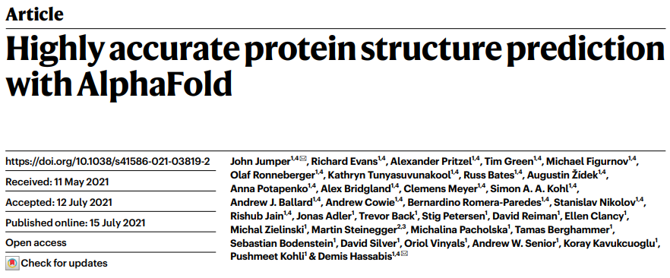
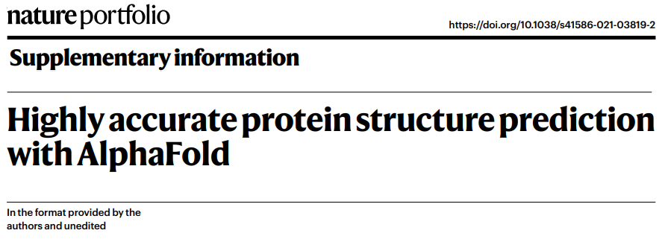
12
+
62

Slide 3
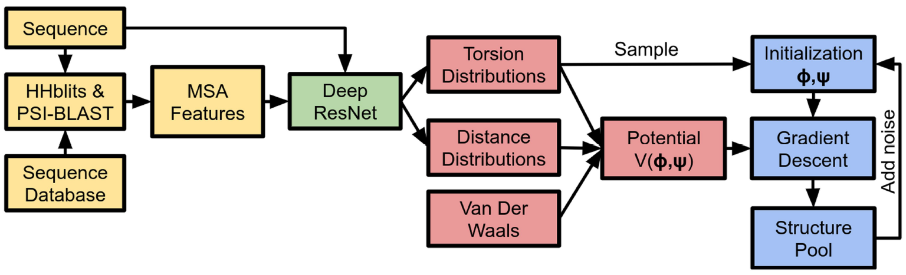
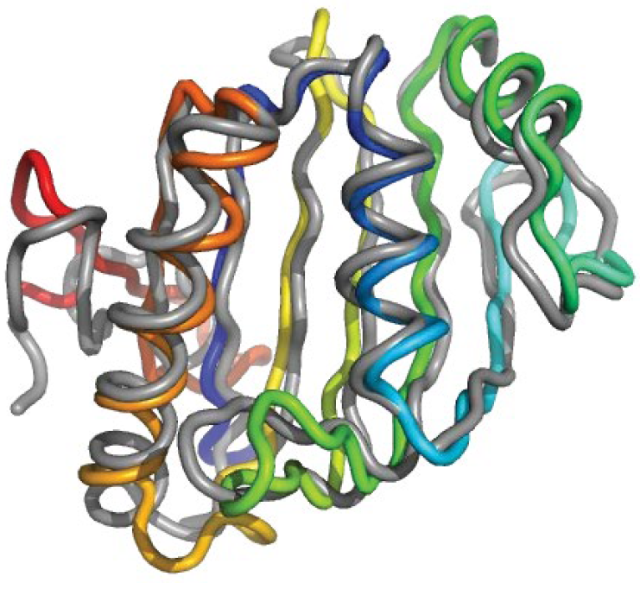
AlphaFold 1
Input
未知sequence, S
$$P_{vonMises}\left(φ_{i},ψ_{i}|S,MSA\left(S\right)\right)$$
MSA$\left(S\right)$
Protein Data Bank (PDB)
多種已知結構
$$P\left(d_{ij}|S,MSA\left(S\right)\right)$$
存在與S類似的homologous sequences
Output

Slide 4
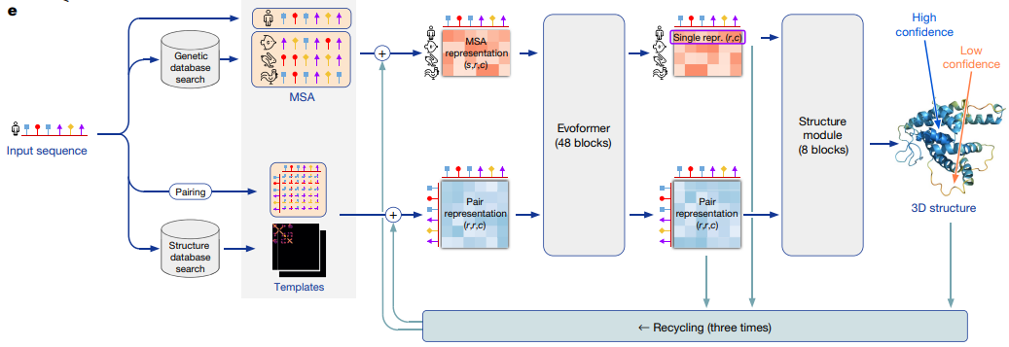
AlphaFold 2

Slide 5
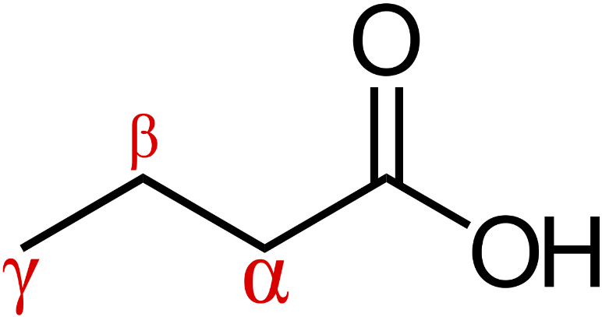
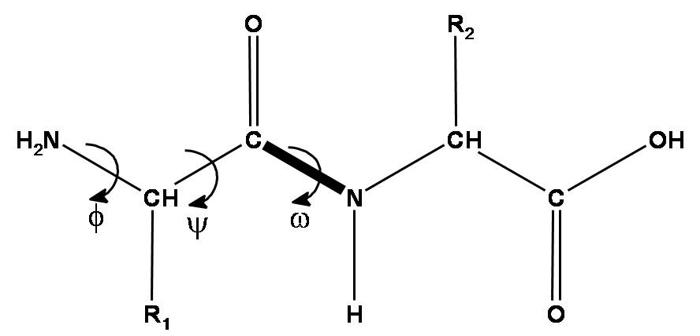
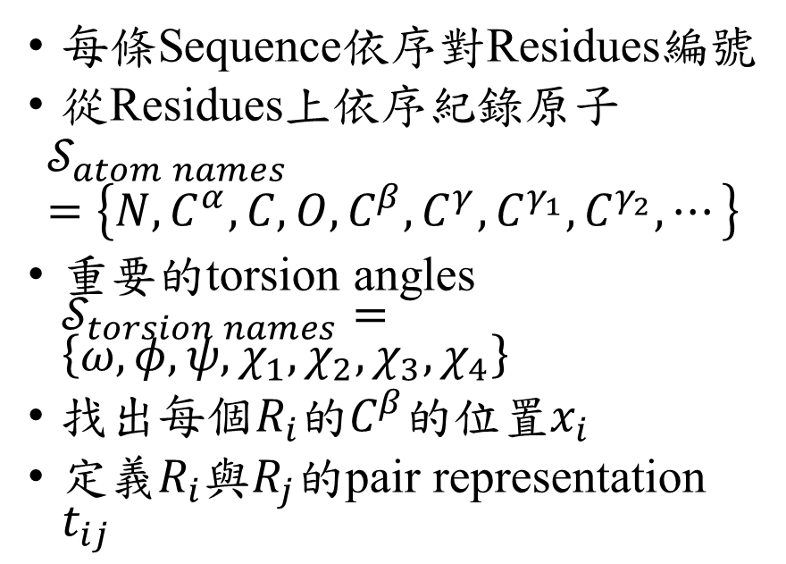
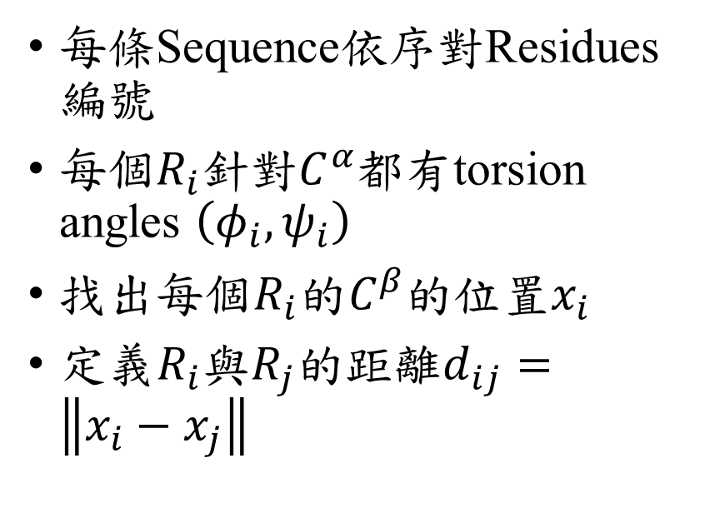
AlphaFold 1
AlphaFold 2
每條Sequence依序對Residues編號
每個$R_{i}$針對$C^{α}$都有torsion angles $\left(φ_{i},ψ_{i}\right)$
找出每個$R_{i}$的$C^{β}$的位置$x_{i}$
定義$R_{i}$與$R_{j}$的距離$d_{ij}=\left\|x_{i}−x_{j}\right\|$
每條Sequence依序對Residues編號
從Residues上依序紀錄原子
$$𝒮_{atom names}=\left\{N, C^{α},C,O,C^{β},C^{γ},C^{γ_{1}},C^{γ_{2}},⋯\right\}$$
重要的torsion angles $𝒮_{torsion names}=\left\{ω,φ,ψ,χ_{1},χ_{2},χ_{3},χ_{4}\right\}$
找出每個$R_{i}$的$C^{β}$的位置$x_{i}$
定義$R_{i}$與$R_{j}$的pair representation $t_{ij}$

Slide 6
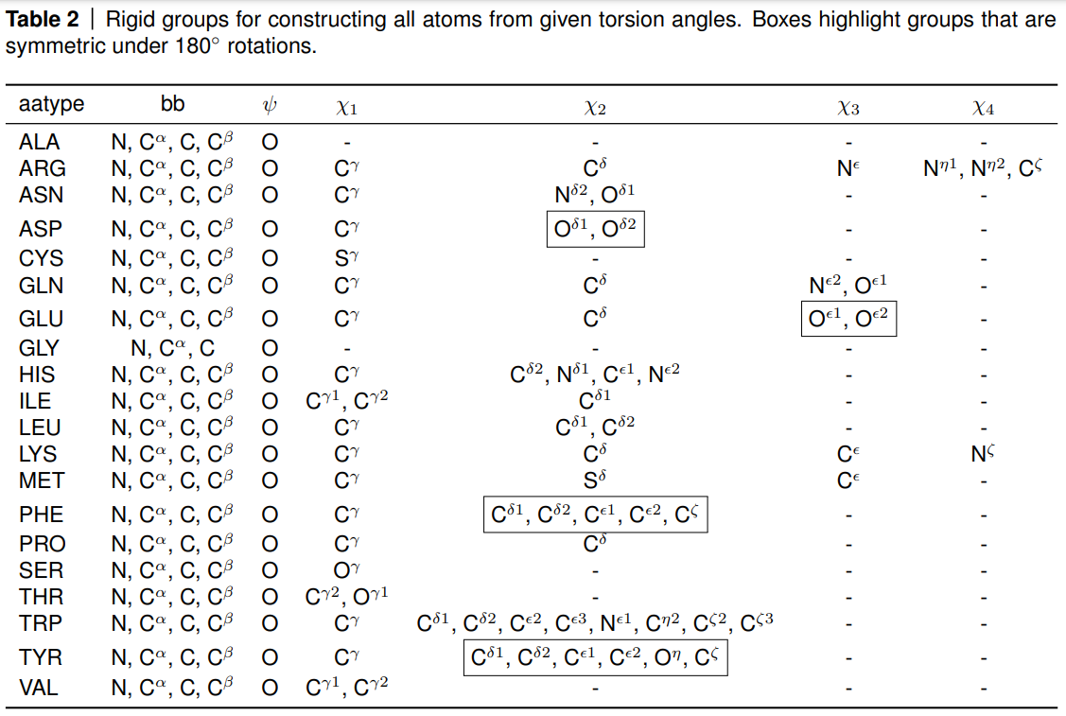
AlphaFold 2: amino acid sequence type (20+1) (Residues)

Slide 7
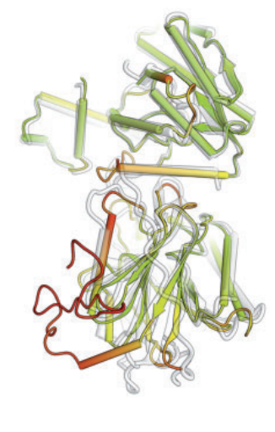
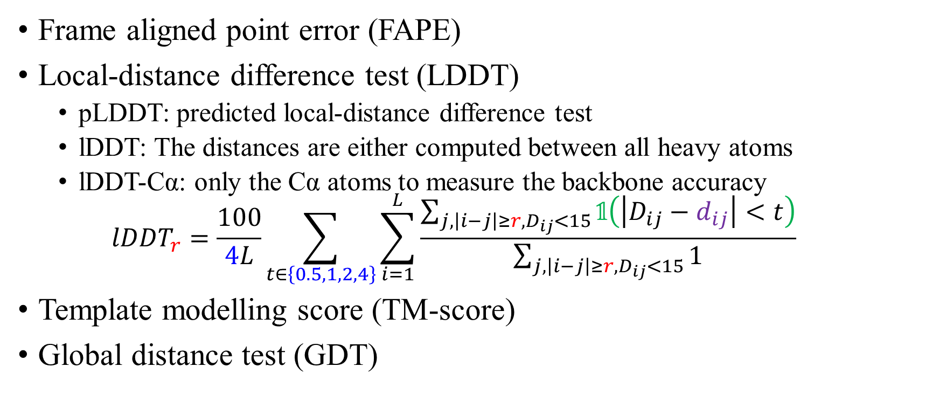
Structure Metrics
Frame aligned point error (FAPE)
Local-distance difference test (LDDT)
pLDDT: predicted local-distance difference test
lDDT: The distances are either computed between all heavy atoms
lDDT-Cα: only the Cα atoms to measure the backbone accuracy
$${lDDT}_{r}=\frac{100}{4L}\sum_{t∈\left\{0.5,1,2,4\right\}}{\sum_{i=1}^{L}{\frac{\sum_{j,\left|i−j\right|≥r,D_{ij}<15}{𝟙\left(\left|D_{ij}−d_{ij}\right|<t\right)}}{\sum_{j,\left|i−j\right|≥r,D_{ij}<15}{1}}}}$$
Template modelling score (TM-score)
Global distance test (GDT)

Slide 8
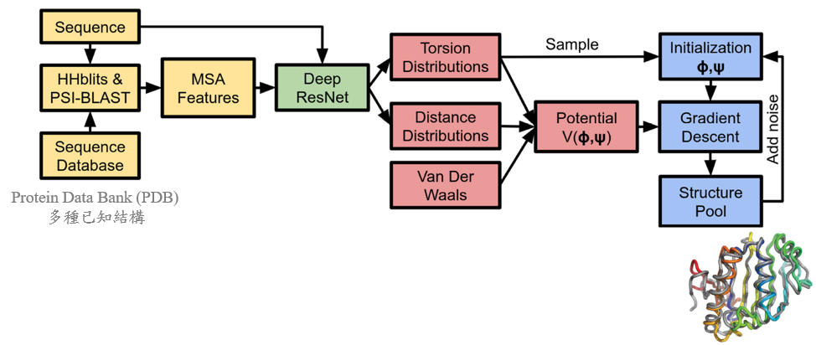
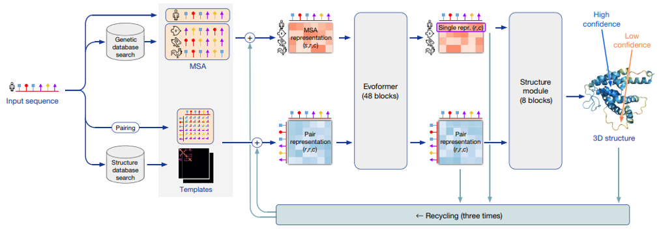
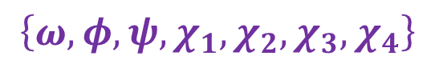
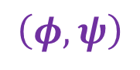
$$\left(φ,ψ\right)$$
m
d
m
z
PDB70
d
$$\left\{ω,φ,ψ,χ_{1},χ_{2},χ_{3},χ_{4}\right\}$$

Slide 9
Training data
75% comes from the self-distillation set + 25% from the PDB
資料前處理
Filters
MSA preprocessing steps
Residue cropping

Slide 10
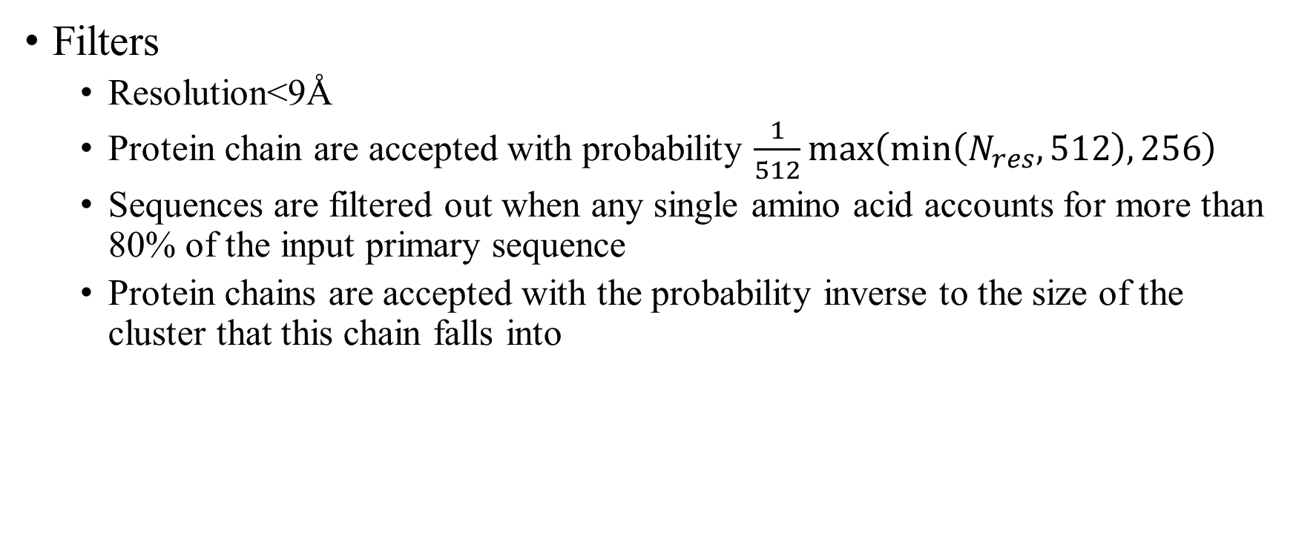
Training data資料前處理 Filters + MSA preprocessing steps + Residue cropping
Filters
Resolution<9Å
Protein chain are accepted with probability $\frac{1}{512}max\left(min\left(N_{res},512\right),256\right)$
Sequences are filtered out when any single amino acid accounts for more than 80% of the input primary sequence
Protein chains are accepted with the probability inverse to the size of the cluster that this chain falls into

Slide 11
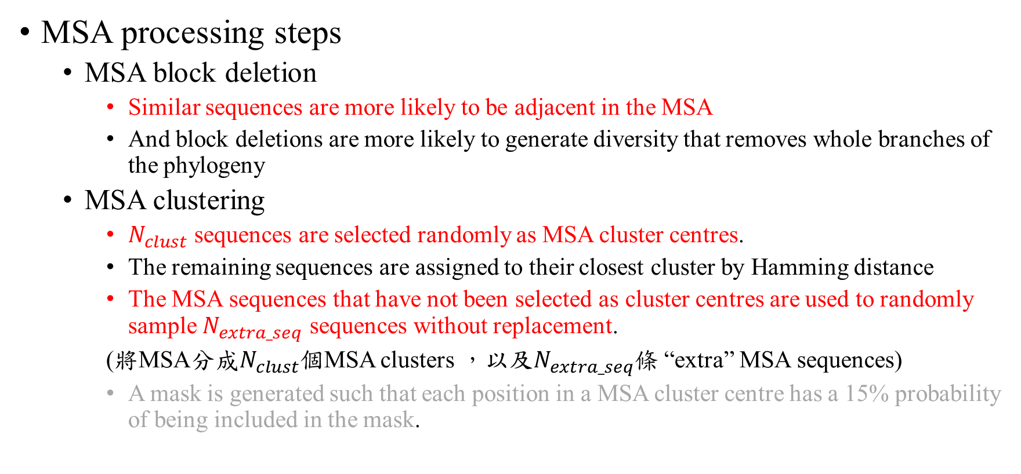
Training data資料前處理 Filters + MSA preprocessing steps + Residue cropping
MSA processing steps
MSA block deletion
Similar sequences are more likely to be adjacent in the MSA
And block deletions are more likely to generate diversity that removes whole branches of the phylogeny
MSA clustering
$N_{clust}$ sequences are selected randomly as MSA cluster centres.
The remaining sequences are assigned to their closest cluster by Hamming distance
The MSA sequences that have not been selected as cluster centres are used to randomly sample $N_{extra_seq}$ sequences without replacement.
(將MSA分成$N_{clust}$個MSA clusters ，以及$N_{extra_seq}$條 “extra” MSA sequences)
A mask is generated such that each position in a MSA cluster centre has a 15% probability of being included in the mask.

Slide 12

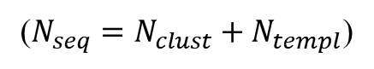
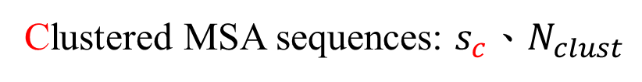
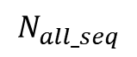
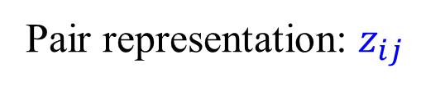
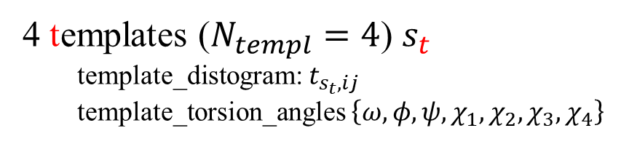
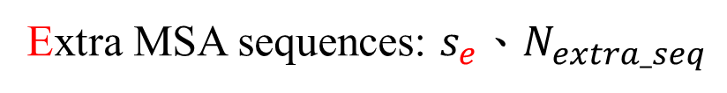
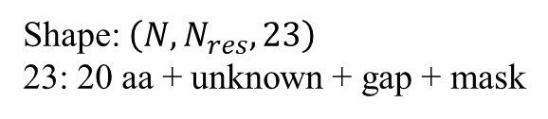
MSA depth
5000 sequences for JackHMMER with Mgnify
10000 sequences for JackHMMER with UniRef90
Unlimited forHHBlits
Shape: $\left(N, N_{res},23\right)$
23: 20 aa + unknown + gap + mask
$$N_{all_seq}$$
Clustered MSA sequences: $s_{c}$、$N_{clust}$
($N_{seq}=N_{clust}+N_{templ}$)
Extra MSA sequences: $s_{e}$、$N_{extra_seq}$
.
.
x
x
.
x
x
.
x
.
.
x
x
x
.
x
x
x
.
Pair representation: $z_{ij}$
.
x
.
x
x
x
.
.
x
x
.
x
.
x
4 templates ($N_{templ}=4$) $s_{t}$
template_distogram: $t_{s_{t}, ij}$
template_torsion_angles $\left\{ω,φ,ψ,χ_{1},χ_{2},χ_{3},χ_{4}\right\}$
PDB70

Slide 13
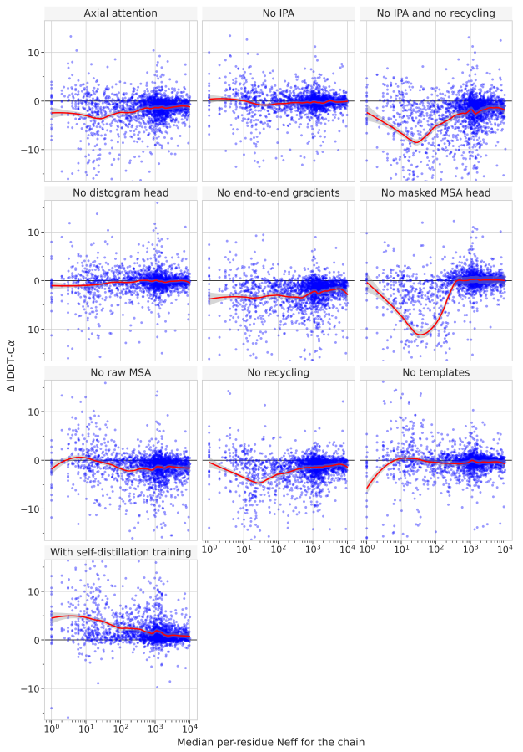
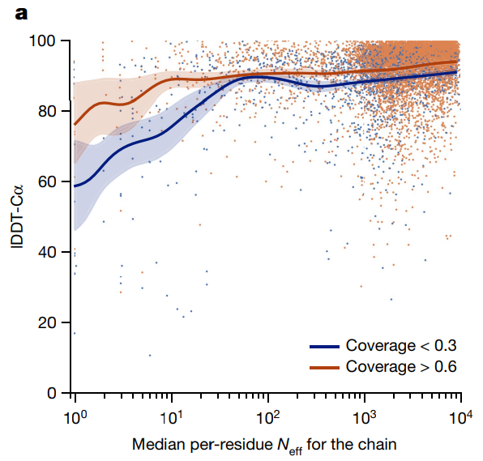
MSA depth
MSA depth analysis was based on
computing the normalized number
of effective sequences (Neff)
for each position of a query sequence

Slide 14
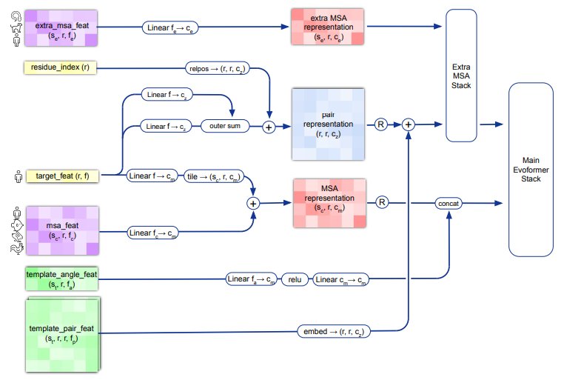
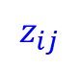
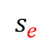
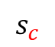
$$s_{e}$$
$$z_{ij}$$
$$s_{c}$$

Slide 15
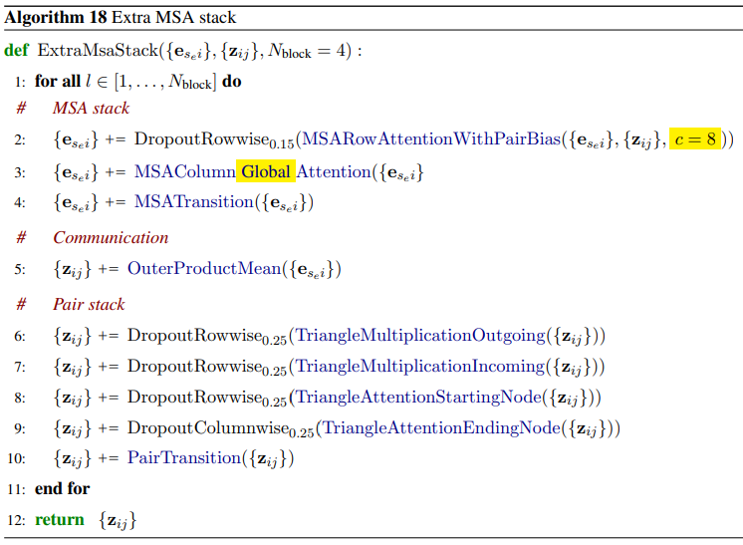
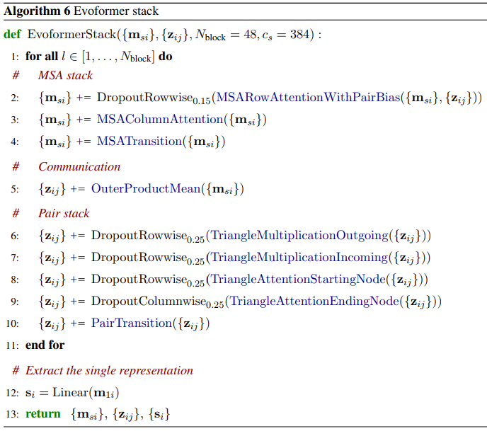
Stack
MSA features
MSA features

Slide 16
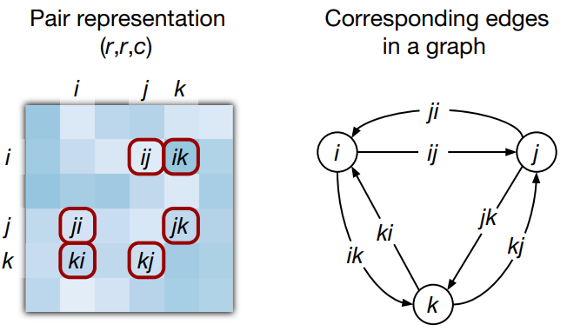
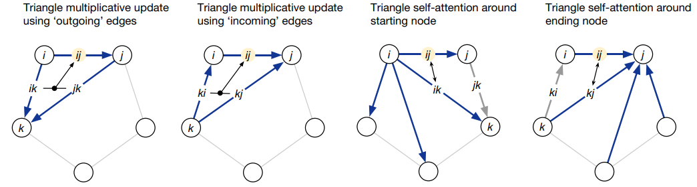
Pair stack
起點
終點
任意經過的點

Slide 17
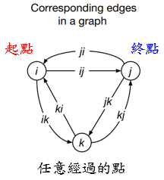
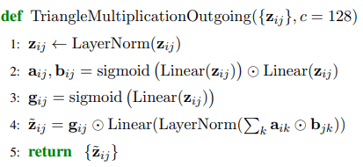
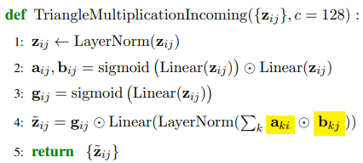

Slide 18
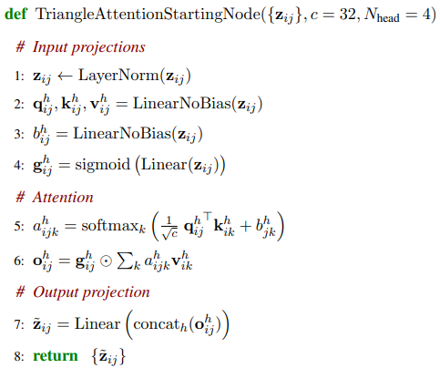
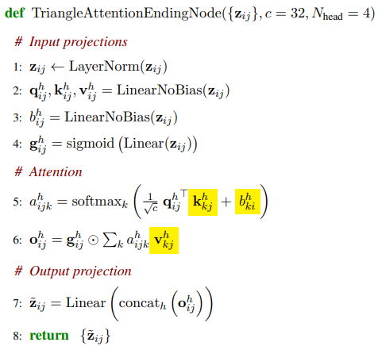

Slide 19
Stack

Slide 20
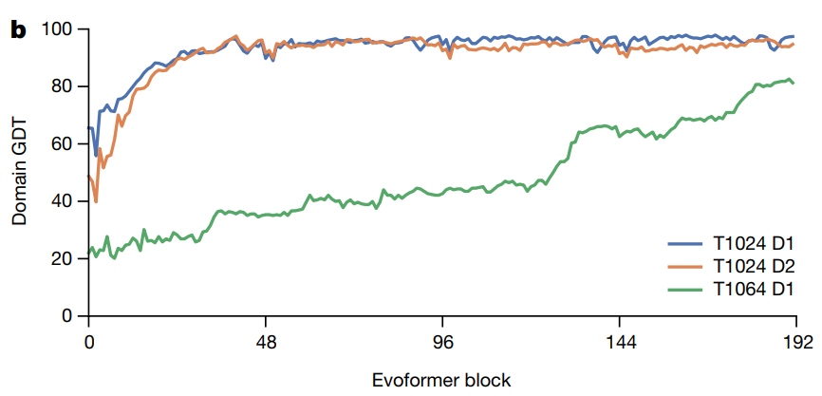

Slide 21
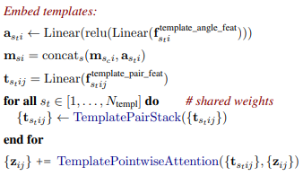
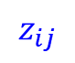


$$s_{e}$$
$$z_{ij}$$
$$s_{c}$$

Slide 22
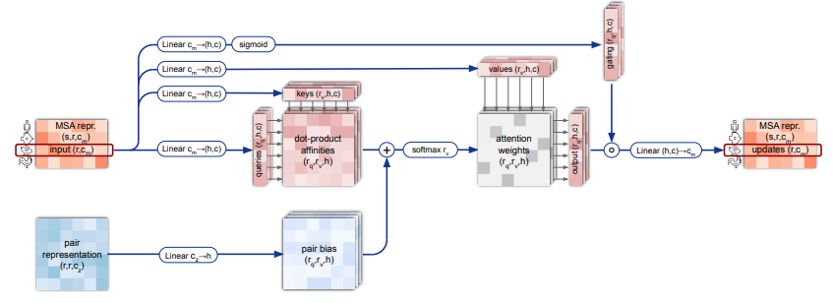
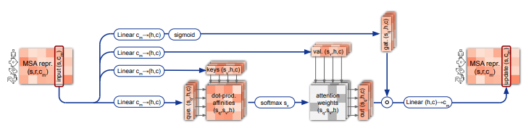
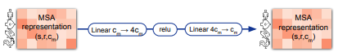
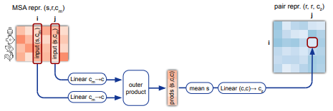
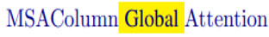
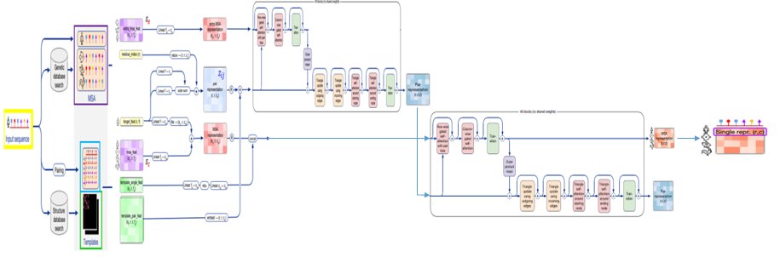
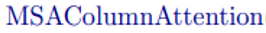


Extra MSA Stack
Main Evoformer Stack

Slide 23


Extra MSA Stack
Main Evoformer Stack

Slide 24


Backbone frame per residue: $T_{i}=\left(R_{i},{\overset{⃑}{t}}_{i}\right)$
$R_{i}$: 3x3 rotation matrix
${\overset{⃑}{t}}_{i}$: 原子$C^{α}在$local上的位置
將local資訊整合到global上
$${\overset{⃑}{x}}_{global}=T_{i}。{\overset{⃑}{x}}_{local}=R_{i}{\overset{⃑}{x}}_{local}+{\overset{⃑}{t}}_{i}$$
每個residue上的原子序列
$$𝒮_{atom names}=\left\{N, C^{α},C,O,C^{β},C^{γ},C^{γ_{1}},C^{γ_{2}},⋯\right\}$$
每個residue上的torsion angles
$$𝒮_{torsion names}=\left\{ω,φ,ψ,χ_{1},χ_{2},χ_{3},χ_{4}\right\}$$
${\overset{⃑}{x}}_{i}^{a}$, $a∈𝒮_{atom names}$
在residue i上的 a 原子在local上的座標
${\overset{⃑}{α}}_{i}^{f}$, $f∈𝒮_{torsion names}$
在residue i上的 f torsion angle (需要sin 與cos)

Slide 25






Structure module
Global
$${\overset{⃑}{x}}_{i}^{a},{\overset{⃑}{α}}_{i}^{f}$$
$$T_{i}=\left(R_{i},{\overset{⃑}{t}}_{i}\right)$$
$$T_{i}$$

Slide 26


Slide 28
Structure Metrics
Frame aligned point error (FAPE)
Local-distance difference test (LDDT)
pLDDT: predicted local-distance difference test
lDDT: The distances are either computed between all heavy atoms
lDDT-Cα: only the Cα atoms to measure the backbone accuracy
$${lDDT}_{r}=\frac{100}{4L}\sum_{t∈\left\{0.5,1,2,4\right\}}{\sum_{i=1}^{L}{\frac{\sum_{j,\left|i−j\right|≥r,D_{ij}<15}{𝟙\left(\left|D_{ij}−d_{ij}\right|<t\right)}}{\sum_{j,\left|i−j\right|≥r,D_{ij}<15}{1}}}}$$
Template modelling score (TM-score)
Global distance test (GDT)

Slide 29


Frame aligned point error (FAPE)

Slide 30

TM-score

Slide 31
AlphaFold 2 表現

Slide 32


Slide 33



Slide 34


Slide 35


Slide 36



Slide 37
The End ~Thank you~

Slide 38





